Slide 1
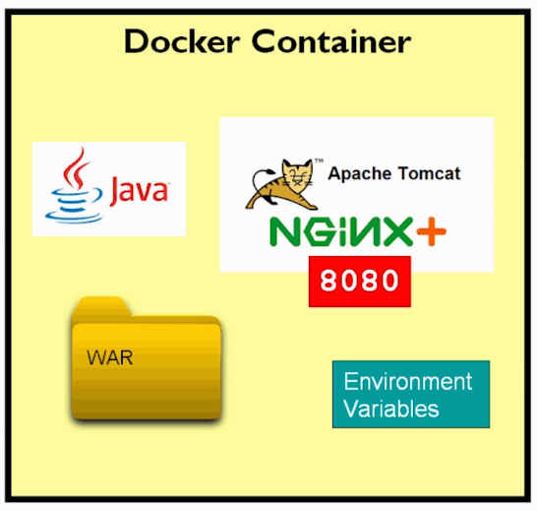
Docker for Java Developers

Slide 2
Agenda
Introduction to docker
Need of docker
docker architecture
Docker essential management commands
Docker spring boot
Docker networking
Docker compose

Slide 3
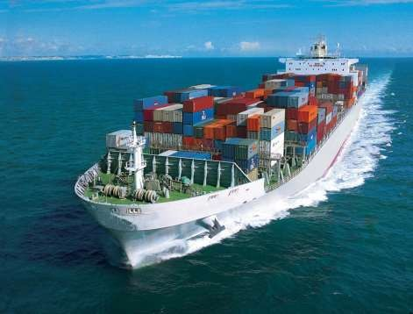
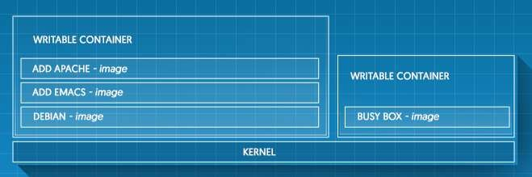
What is Docker?
Docker containers wrap a piece of software in a complete filesystem that contains everything needed to run: code, runtime, system tools, system libraries – anything that can be installed on a server. This guarantees that the software will always run the same, regardless of its environment.
[www.docker.com]

Slide 4
What is Docker?
Developers use Docker to eliminate “works on my machine” problems when collaborating on code with co-workers.
Operators use Docker to run and manage apps side-by-side in isolated containers to get better compute density.
Enterprises use Docker to build agile software delivery pipelines to ship new features faster, more securely and with confidence for both Linux and Windows Server apps.
© 2016 Progress Software Corporation and/or its subsidiaries or affiliates. All rights reserved.

Slide 5
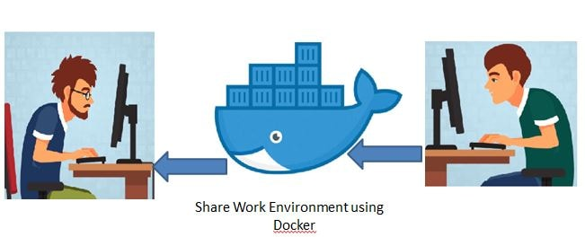
Need of Docker
Docker is a tool designed to make it easier to create, deploy, and run applications by using containers.
Containers allow a developer to package up an application with all of the parts it needs, such as libraries and other dependencies, and ship it all out as one package.
Create self-contained development environments inside Docker containers.
So we share an environment already configured.
The application is running on
my dev machine but not in
production

Slide 6
Docker Container
A container is a runtime instance of an image what the image becomes in memory when actually executed.
It runs completely isolated from the host environment by default, only accessing host files and ports if configured to do so.

Slide 7
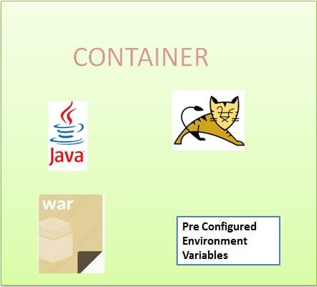
Docker Image?
An image is a lightweight, stand-alone, executable package that includes everything needed to run a piece of software, including the code, a runtime, libraries, environment variables, and config files
So an existing fellow developer will create an image of his environment and share it with the new developer. The new developer will just have to run the image as a docker container.

Slide 8
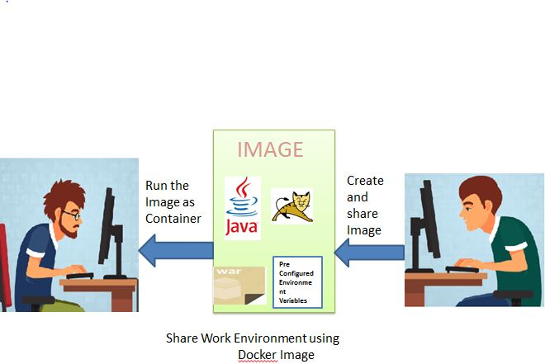
Docker Image?

Slide 9
use of docker for Java Developers
Sharing development workspace, with preconfigured development environment.
Continuous integration is one of the most popular use cases for Docker. Teams looking build and deploy their applications quickly use Docker, combined with ecosystem tools like Jenkins, to drive apps from dev, testing staging and into production without having to change any code.

Slide 10
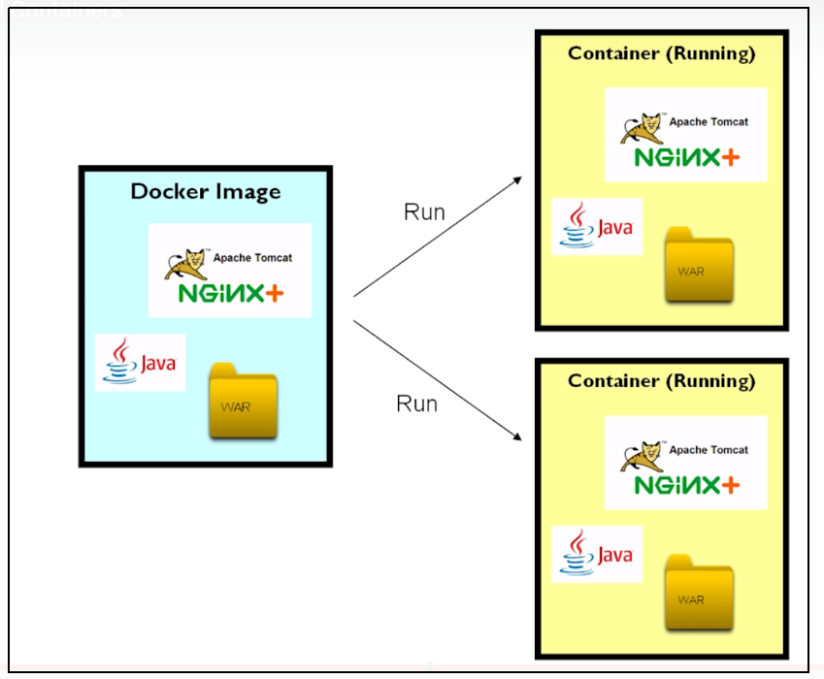
Docker image and containers

Slide 11
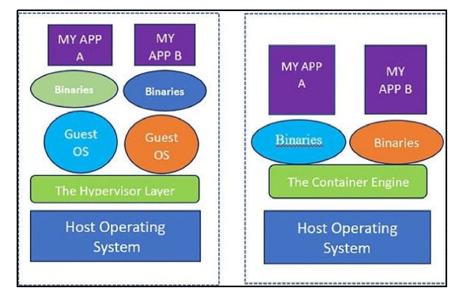
Docker vs VM

Slide 12
Concept of Containerization
The foundation of Containerization lies in the Linux Container (LXC) format. LXC is an operaeting system level virtualization method for running multiple isolated linux system (Containers) on an control host using a single Linux Kernel
The fundamental difference between VMS and Containers is that a container does not require its own OS, Thus making it more lightweight then a VM. VM is slow to boot and take a long time to start up as compraed to Containers
Container is light weight and cost effective,as it share the machine OS kernel and dont required cost of associating an operating system with each application

Slide 13
Advantage of Containerization
It works on my system:May be possible an lib is missing on production env
Cost effective
light weight, performance
security, due to namespace, our app is going to sandboxed and dont communicate with each other unless we configure
Dev can use exact same sw environment for both development and production
Used with CI/CD pipeline integration, helping dev become more productive and efficient
Support microservice arch
Support scaling: scale up and scale down

Slide 14
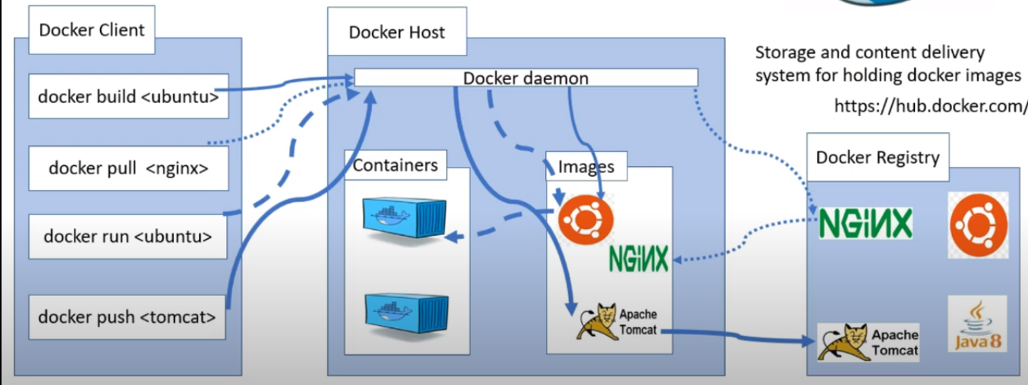
Docker architecture

Slide 15
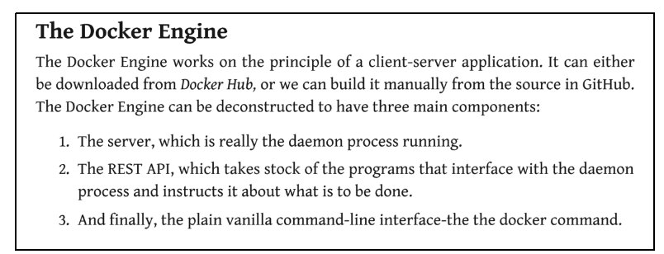
Docker Components
Docker is a piece of software that create, manages, administrates and orchestrates containers.
Docker is not a single monolithic application but made up of the components like containerd, runc, InfraKit and so on

Slide 16
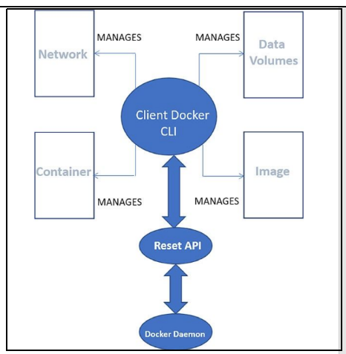
Docker Engine component flow
Docker REST api provides a CLI for intracting with docker deamon
Docker daemon is responsible for heavy lifting of creating, administrering and managing docker containres, images, network storages, volume etc

Slide 17
Docker Hub and Docker Registry
A Registry defined as storage and contect delivery system.
They hold docker images which are available in different tagged versions. Docker Registry is a service that is holding our docker images.
Docker registry could also be hosted by a third party, as a public or private registry,
Ex: Docker hub, AWS Container Registry, Google container aRegistry etc

Slide 18
Docker essential management commands

Slide 19
Docker essential Commnds
docker -v: checking docker version
docker --version
docker info: give complete info about docker, how many container running, pause etc
docker –help: give help about each command
docker images: give details of all images on local docker installation
docker images --help

Slide 20
Docker images/containers Commnds
docker images: give details of all images on local docker installation
docker images –help
docker pull ubuntu:latest
docker image rm <id>
docker container ls -a
docker container run -it ubuntu ctr+q ctr+q
docker container stop <id>
docker container start <id>
docker ps -a
docker rm <id> removing all containers
docker rmi -f $(docker images -a -q) remove all images
docker system prune delete everythings

Slide 21
Docker pulling and running images
Ubuntu image
docker pull ubuntu:latest
docker container run -it ubuntu
apt-get update && apt-get install git
apt-get install openjdk-11-jdk
Tomcat image
docker image pull tomcat:latest
docker contrainer run -d -p 8080:8080 tomcat
(stop any container running on port 8080)
docker container log -f <id>

Slide 22
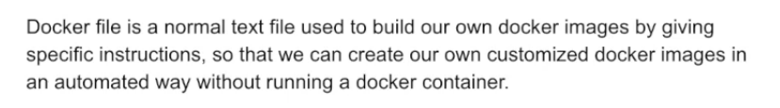
Docker file

Slide 23
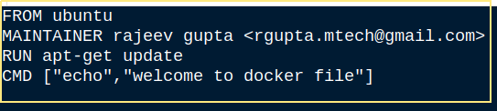
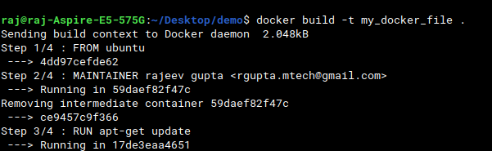
Docker file: creating running

Slide 24
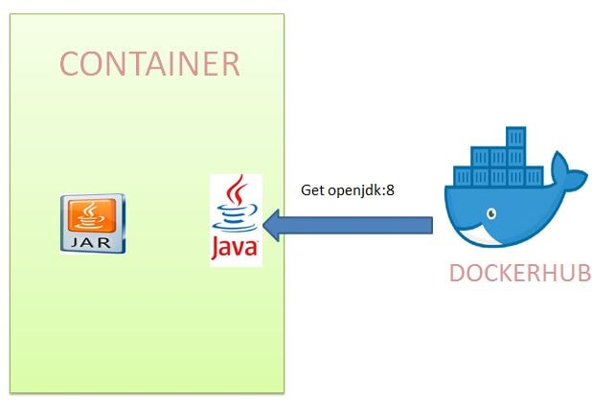
Spring boot docker hello world

Slide 25
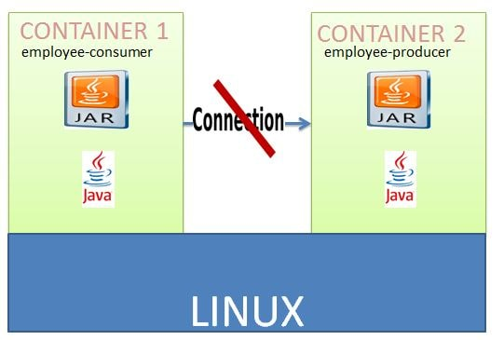
Docker networking
The way Docker has been designed such that a Docker Container should have only a single service running. Again we can have multiple services running in docker using some workarounds but this will not be a good design.
So we will be deploying the two microservices employee-producer and employee-consumer to two different containers and then have them interact with each other.
In order to achieve this will have to make use of the docker networking commands.

Slide 26
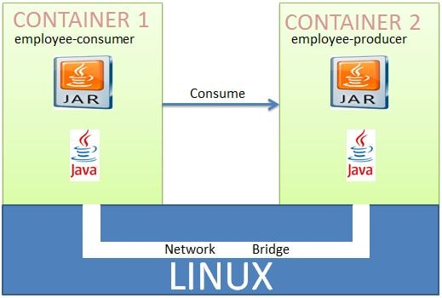
Inter Docker Container Communication Using Docker Networking
We will be using Docker Networking to allow multiple containers to interact with each other.
We will need to create our own network and add both the employee-producer and employee-consumer services to it. We will stop and remove the existing docker containers named consumer and producer.

Slide 27
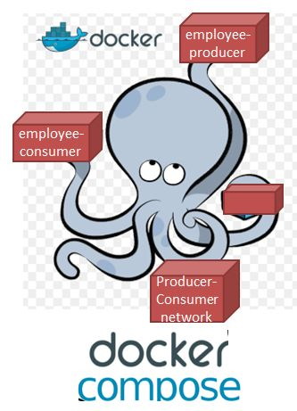
Deploying Multiple Spring Boot Microservices using Docker Compose
Compose is a tool for defining and running multi-container Docker applications. With Compose, you use a YAML file to configure your application's services. Then, with a single command, you create and start all the services from your configuration.
Using docker-compose we will be creating the custom network named consumer-producer and then starting the containers employee-producer and employee consumer.

